Slide 1
ECE314 Lab 4 Overview
Standardized random variables
Parameter estimation
ML
MAP
Confidence intervals

Slide 2
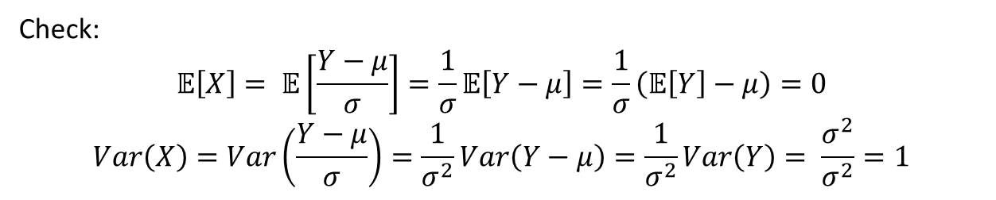

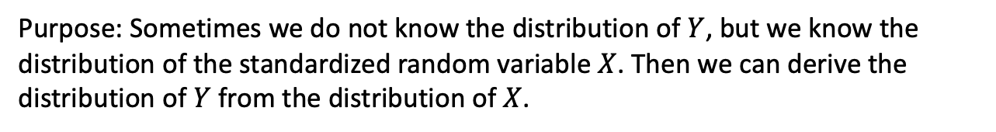
Standardized random variables
mean = 0
variance = 1
Given any random variable $Y$ with mean $μ$ and variance $σ^{2}$, its standardized version random variable is X, defined by
$$X= \frac{Y−μ}{σ}$$
Check:
$$𝔼\left[X\right]= 𝔼\left[\frac{Y−μ}{σ}\right]=\frac{1}{σ}𝔼\left[Y−μ\right]=\frac{1}{σ}\left(𝔼\left[Y\right]−μ\right)=0$$
$$Var\left(X\right)=Var\left(\frac{Y−μ}{σ}\right)=\frac{1}{σ^{2}}Var\left(Y−μ\right)=\frac{1}{σ^{2}}Var\left(Y\right)= \frac{σ^{2}}{σ^{2}}=1$$
Purpose: Sometimes we do not know the distribution of $Y$, but we know the distribution of the standardized random variable $X$. Then we can derive the distribution of $Y$ from the distribution of $X$.
See Section 2.2 of ECE313 notes and Lab 4 for more details

Slide 3
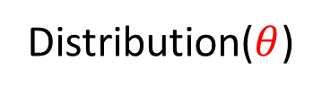
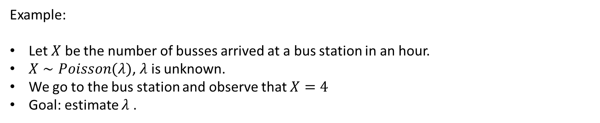
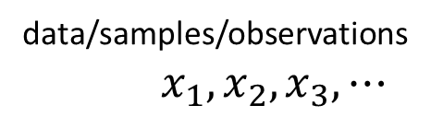
Parameter estimation
unknown
generate
data/samples/observations $x_{1}, x_{2}, x_{3}, ⋯$
Distribution($θ$)
estimate
Example:
Let $X$ be the number of busses arrived at a bus station in an hour.
$X∼Poisson(λ)$, $λ$ is unknown.
We go to the bus station and observe that $X=4$
Goal: estimate $λ$ .

Slide 4

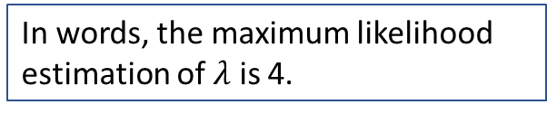
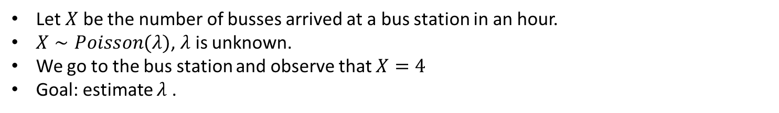



Parameter estimation: maximum likelihood (ML) estimation
Let $X$ be the number of busses arrived at a bus station in an hour.
$X∼Poisson(λ)$, $λ$ is unknown.
We go to the bus station and observe that $X=4$
Goal: estimate $λ$ .
Principle: choose the estimate that maximizes the likelihood/probability of obtaining the observations.
pmf: $p_{X}\left(k\right)= \frac{λ^{k}}{k!}e^{−λ}$
likelihood: $p_{X}\left(4\right)= \frac{λ^{4}}{4!}e^{−λ}$
Let
$\frac{d}{dλ}\left(\frac{λ^{4}}{4!}e^{−λ}\right)= \frac{{λ^{3}e}^{−λ}}{4!}\left(4−λ\right)$ = 0
$${\hat{λ}}_{ML}=4$$
In words, the maximum likelihood estimation of $λ$ is 4.

Slide 5

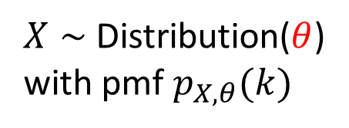
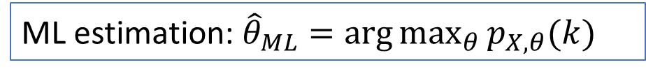
Parameter estimation: maximum likelihood (ML) estimation
unknown
generate
$X∼$ Distribution($θ$)
with pmf $p_{X,θ}(k)$
Observation: $X=k$
estimate
ML estimation: ${\hat{θ}}_{ML}=\arg{\max_{θ}{p_{X,θ}(k)}}$

Slide 6

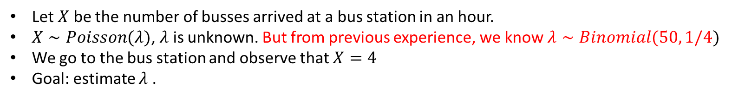


Parameter estimation: maximum a posteriori (MAP) estimation
Let $X$ be the number of busses arrived at a bus station in an hour.
$X∼Poisson(λ)$, $λ$ is unknown. But from previous experience, we know $λ∼Binomial(50, 1/4)$
We go to the bus station and observe that $X=4$
Goal: estimate $λ$ .
prior distribution
Principle: choose the estimate that maximizes the a posteriori (conditional) probability of the parameter given the observation.
$$\operatorname{Pr}{(λ=i|X=4)} \\ = \frac{\operatorname{Pr}\left(X=4 | λ=i\right)\operatorname{Pr}{(λ=i)}}{\operatorname{Pr}{(X=4)}} \\ = \frac{1}{\operatorname{Pr}{(X=4)}}\left(\frac{i^{4}}{4!}e^{−i} \left({50 \atop i}\right){\left(\frac{1}{4}\right)}^{i}{\left(1−\frac{1}{4}\right)}^{50−i} \right)$$
By Bayes formula
Doesn’t depend on $i$
Maximize with respect to $i$ to get ${\hat{λ}}_{MAP}$

Slide 7

Parameter estimation: maximum a posteriori (MAP) estimation
Unknown with a prior distribution $p(θ)$
generate
$X∼$ Distribution($θ$)
with pmf $p_{X,θ}(k)$
Observation: $X=k$
estimate
MAP estimation: ${\hat{θ}}_{MAP}=\arg{\max_{θ}{p_{X,θ}\left(k\right) p(θ)}}$

Slide 8

ML vs. MAP
ML estimation: ${\hat{θ}}_{ML}=\arg{\max_{θ}{p_{X,θ}(k)}}$
MAP estimation: ${\hat{θ}}_{MAP}=\arg{\max_{θ}{p_{X,θ}\left(k\right) p(θ)}}$
See Section 2.11 of ECE313 notes for details

Slide 9

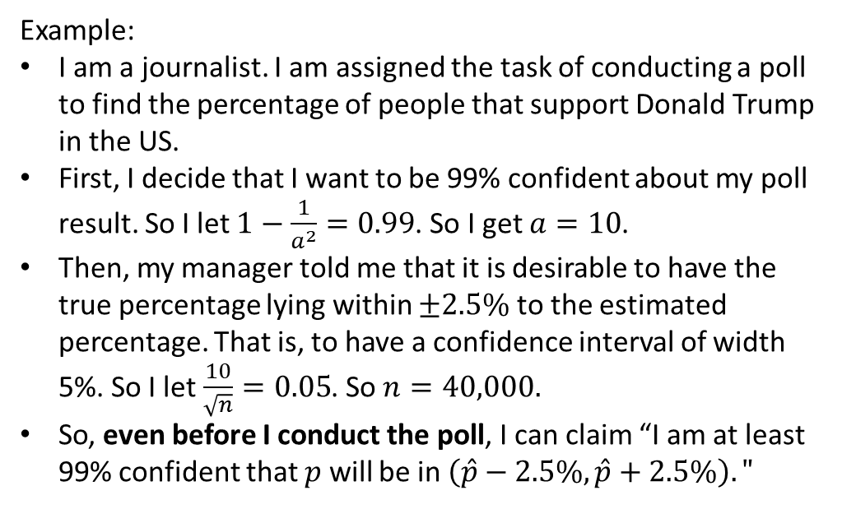
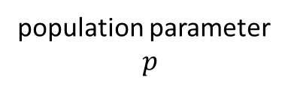
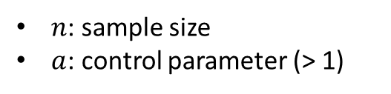
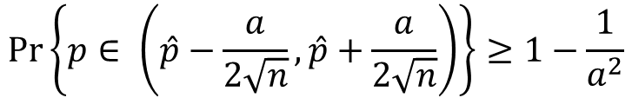

Confidence interval
population parameter
$$p$$
sample estimation $\hat{p}$
Q: how good is the estimation $\hat{p}$ ?
Example:
I am a journalist. I am assigned the task of conducting a poll to find the percentage of people that support Donald Trump in the US.
First, I decide that I want to be 99% confident about my poll result. So I let $1−\frac{1}{a^{2}}=0.99$. So I get $a=10$.
Then, my manager told me that it is desirable to have the true percentage lying within $±2.5\%$ to the estimated percentage. That is, to have a confidence interval of width 5%. So I let $\frac{10}{\sqrt{n}}=0.05$. So $n=40,000.$
So, even before I conduct the poll, I can claim “I am at least 99% confident that $p$ will be in $\left(\hat{p}−2.5\%, \hat{p}+2.5\%\right)."$
$$\operatorname{Pr}\left\{p∈ \left(\hat{p}−\frac{a}{2\sqrt{n}}, \hat{p}+\frac{a}{2\sqrt{n}}\right)\right\}≥1−\frac{1}{a^{2}}$$
Confidence interval
Confidence level
$n$: sample size
$a$: control parameter (> 1)
See Section 2.9 of ECE313 notes for details

Slide 10
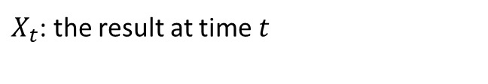
Bernoulli process: four ways of description
$$t 1 2 3 4 5 6 7 8 9 10$$
$X_{t}$: the result at time $t$
$$X 0 1 0 1 0 0 1 1 1 0$$

Slide 11


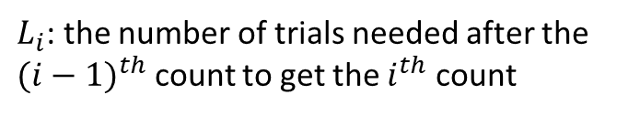




Bernoulli process: four ways of description
$$t 1 2 3 4 5 6 7 8 9 10$$
$X_{t}$: the result at time $t$
$$X 0 1 0 1 0 0 1 1 1 0$$
$L_{i}$: the number of trials needed after the ${(i−1)}^{th}$ count to get the $i^{th}$ count
$$L$$
$$2$$
$$2$$
$$3$$
$$1$$
$$1$$

Slide 12







Bernoulli process: four ways of description
$$t 1 2 3 4 5 6 7 8 9 10$$
$X_{t}$: the result at time $t$
$$X 0 1 0 1 0 0 1 1 1 0$$
$L_{i}$: the number of trials needed after the ${(i−1)}^{th}$ count to get the $i^{th}$ count
$$L$$
$$2$$
$$2$$
$$3$$
$$1$$
$$1$$
$S_{i}$: the time the $i^{th}$ count occurs
$$S$$
$$2$$
$$4$$
$$7$$
$$8$$
$$9$$

Slide 13



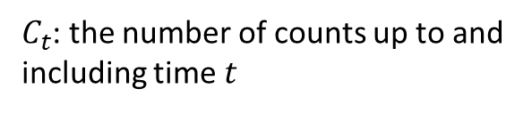








Bernoulli process: four ways of description
$$t 1 2 3 4 5 6 7 8 9 10$$
$X_{t}$: the result at time $t$
$$X 0 1 0 1 0 0 1 1 1 0$$
$L_{i}$: the number of trials needed after the ${(i−1)}^{th}$ count to get the $i^{th}$ count
$$L$$
$$2$$
$$2$$
$$3$$
$$1$$
$$1$$
$S_{i}$: the time the $i^{th}$ count occurs
$$S$$
$$2$$
$$4$$
$$7$$
$$8$$
$$9$$
$$4$$
$$5$$
$C_{t}$: the number of counts up to and including time $t$
$$C$$
$$0$$
$$1$$
$$1$$
$$2$$
$$2$$
$$2$$
$$3$$
$$5$$

Slide 14
Bernoulli process: four ways of description
$$t 1 2 3 4 5 6 7 8 9 10$$
$X_{t}$: the result at time $t$
$$X 0 1 0 1 0 0 1 1 1 0$$
$L_{i}$: the number of trials needed after the ${(i−1)}^{th}$ count to get the $i^{th}$ count
$$L$$
$$2$$
$$2$$
$$3$$
$$1$$
$$1$$
$S_{i}$: the time the $i^{th}$ count occurs
$$S$$
$$2$$
$$4$$
$$7$$
$$8$$
$$9$$
$$4$$
$$5$$
$C_{t}$: the number of counts up to and including time $t$
$$C$$
$$0$$
$$1$$
$$1$$
$$2$$
$$2$$
$$2$$
$$3$$
$$5$$
The four different descriptions are equivalent: knowing one gives you the other three.
Covered in Section 2.6 of ECE313 notes

Slide 15



Poisson distribution vs. Binomial distribution
$$X∼Poisson(λ)$$
$$Y∼Binomial(n,p)$$
$$pmf: \operatorname{Pr}\left(X=k\right)=\frac{λ^{k}}{k!}e^{−λ}, k≥0$$
$$pmf: \operatorname{Pr}\left(Y=k\right)= \left({n \atop k}\right)p^{k}{\left(1−p\right)}^{n−k}, 0≤k≤n$$

Slide 16
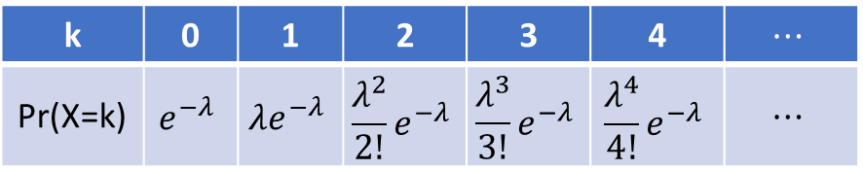
Poisson distribution vs. Binomial distribution
$$X∼Poisson(λ)$$
$$Y∼Binomial(n,p)$$
$$pmf: \operatorname{Pr}\left(X=k\right)=\frac{λ^{k}}{k!}e^{−λ}, k≥0$$
$$pmf: \operatorname{Pr}\left(Y=k\right)= \left({n \atop k}\right)p^{k}{\left(1−p\right)}^{n−k}, 0≤k≤n$$
k | 0 | 1 | 2 | 3 | 4 | $$⋯$$
Pr(X=k) | $$e^{−λ}$$ | $$λe^{−λ}$$ | $$\frac{λ^{2}}{2!}e^{−λ}$$ | $$\frac{λ^{3}}{3!}e^{−λ}$$ | $$\frac{λ^{4}}{4!}e^{−λ}$$ | $$⋯$$

Slide 17
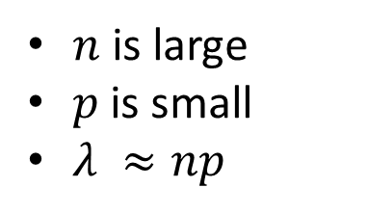

Poisson distribution vs. Binomial distribution
$$≈$$
$$X∼Poisson(λ)$$
$$Y∼Binomial(n,p)$$
$$pmf: \operatorname{Pr}\left(X=k\right)=\frac{λ^{k}}{k!}e^{−λ}, k≥0$$
$$pmf: \operatorname{Pr}\left(Y=k\right)= \left({n \atop k}\right)p^{k}{\left(1−p\right)}^{n−k}, 0≤k≤n$$
$n$ is large
$p$ is small
$λ ≈np$
See Section 2.7 of ECE313 notes for a proof
Example: You are given a distribution $Y∼Bernoulli(2000, 0.001)$. You want to find $P(Y=3)$.
Let $λ=2000 ∗0.001=2$ and let $X∼Poisson(2)$. Then $P\left(Y=3\right)≈P\left(X=3\right)= \frac{2^{3}}{3!}e^{−2}=\frac{4}{3}e^{−2}.$

